Slide 1

Autonomous Artistic Robot
GROUP MEMBERS
VINEET KAKATI
GANESH DHURI
BHAVESH KHETPAL

Slide 2
Problem Statement
It comprises of the creation of a swarm of robots capable of drawing a multicoloured image autonomously.
It consists of a computer system which gives the input to bots via Zigbee protocol. Each bot is responsible for drawing only a particular colour.
The input would be a multicoloured image which the system would process, i.e. using image processing techniques.

Slide 3
The system would then communicate the required information to the bots.
Each bot would then, by working in turns, start drawing the part of the image, that is coloured as the colour it is responsible for.

Slide 4
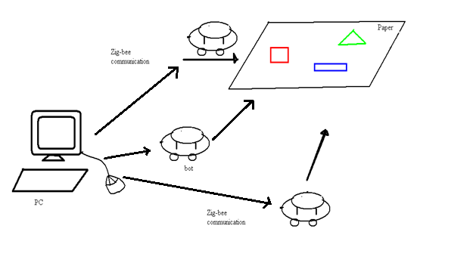
Proposed System

Slide 5
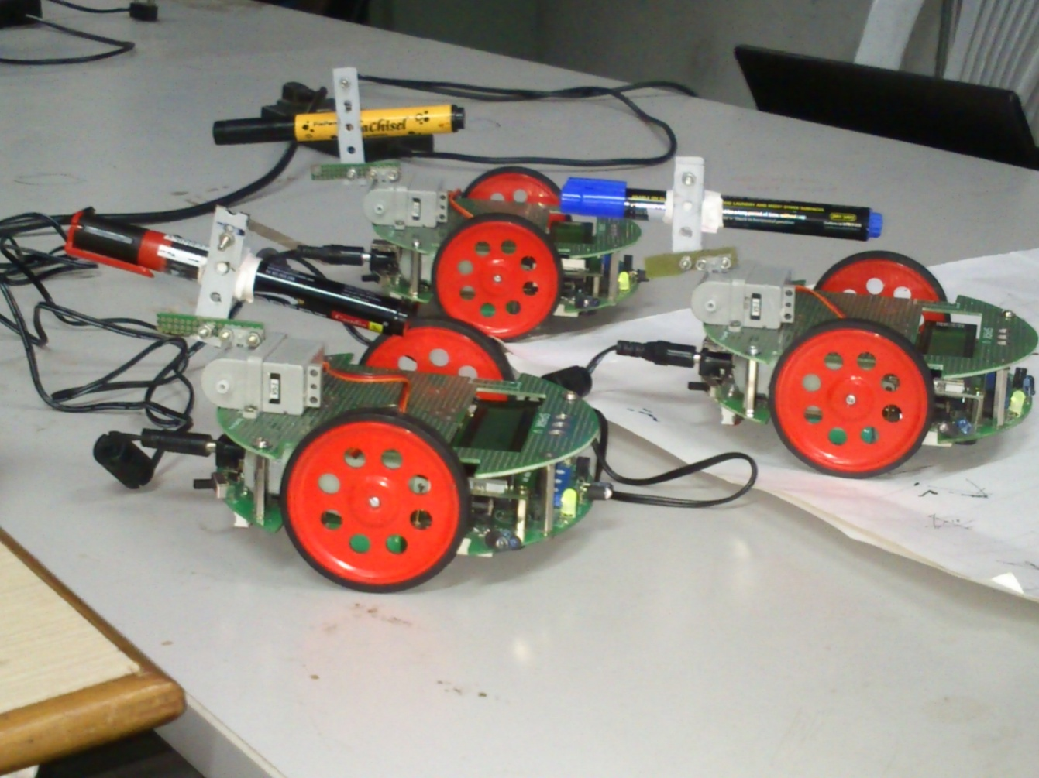
SWARM ROBOTS

Slide 6
Methodology
Mapping the canvass(paper) to a virtual grid
Setting up input image, processing it using MATLAB to obtain image matrix.
Analyzing the image matrix.
Synthesizing the motion control code based on matrix.
Setting up the swarm environment to carry out task.

Slide 7
Image processing

Slide 8

The above image is the sample image being given as input to MATLAB.
MATLAB detects the different colours present in the sample image, i.e. R G & B, and processes each colour separately.

Slide 9



Slide 10

As is clear from the above images, each shape is colored differently.
MATLAB separates the differently colored shapes at runtime, thus it isolates those parts of the image having different colors, R G & B.

Slide 11
Another function has been developed by us in MATLAB which detects the corner pixels of each shape.
As MATLAB isolates each shape, it detects corner pixels for each shape, denoted by red marking at each shape corner.
Using these corner pixels, MATLAB calculates length of side of the shape and also angle between 2 sides of a shape, which are required by the robot.

Slide 12
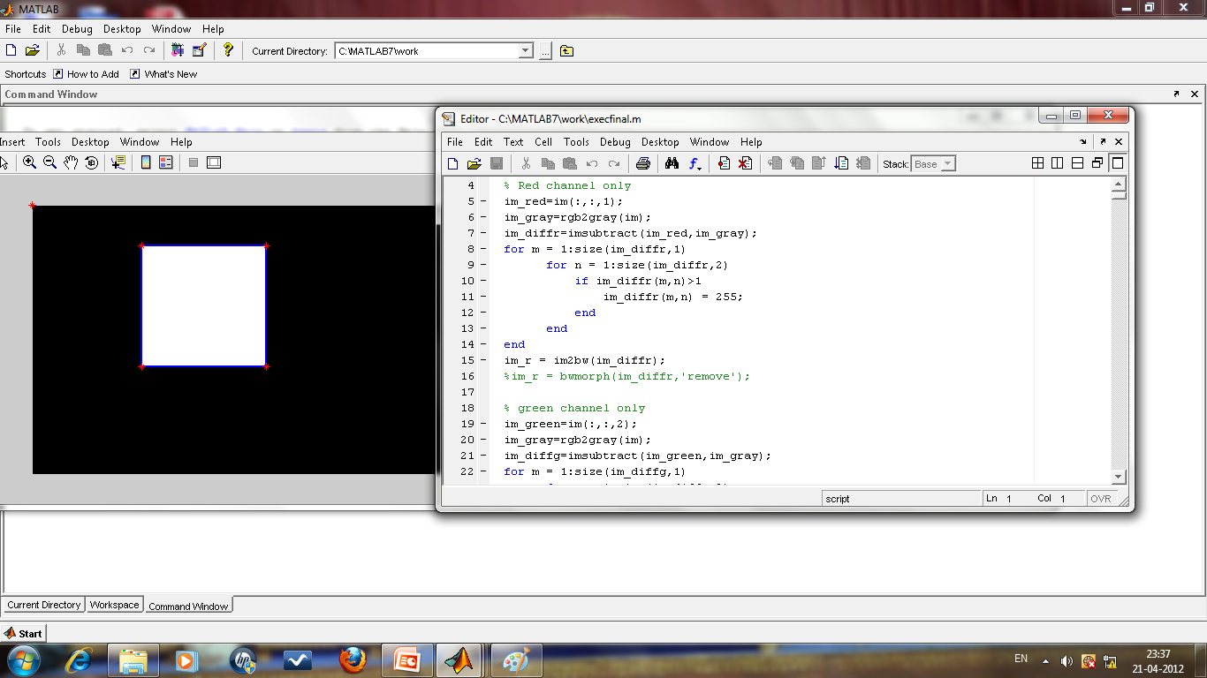
Screen shot of MATLAB window

Slide 13
Setting up swarm environment

Slide 14
Swarm consists of 3 spark V robots
A Xbee Module with chip antenna will be connected to each of the robot
A XBee module with USB socket will be connected to controller(PC).
The controller will the communicate instructions wirelessly to Robots
Each bot also has a pen/ marker i.e. a colouring utility which is red ,green or blue(rgb).
This utility is powered by a servo motor capable of up down motion

Slide 15
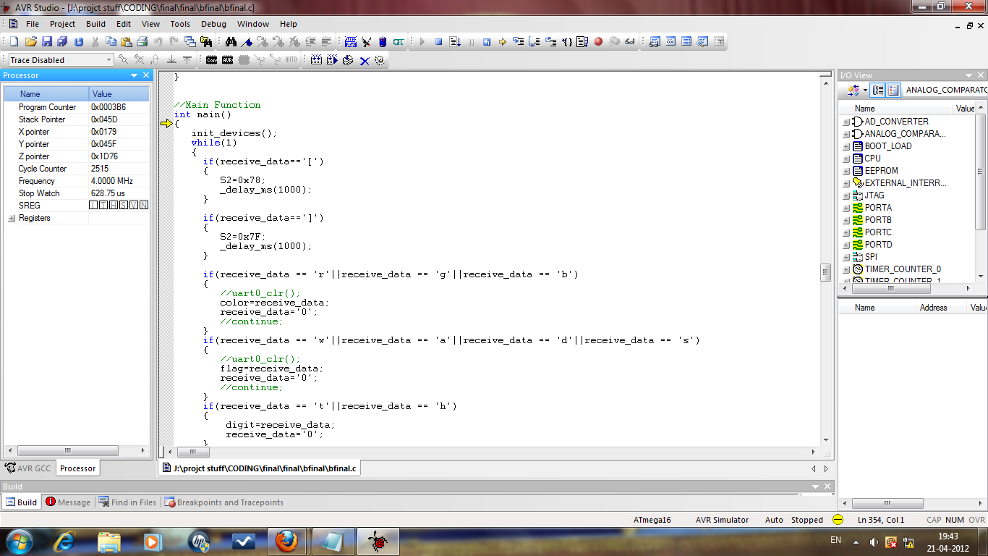
Screen shot of AVR STUDIO window
AVR STUDIO is the software used to program the microcontroller in embedded C.

Slide 16
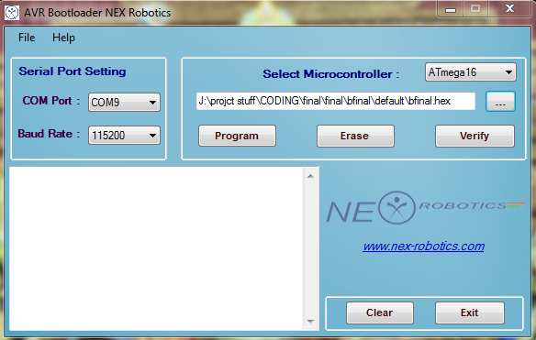
Screen shot of AVR BOOTLOADER window
AVR BOOTLOADER is the software used for burning or writing the C program into the robot’s Microcontroller.

Slide 17
Scope of Project
Study of Spark V robot
Study Of ZigBee and Image Processing using Matlab
Setting up the Canvass
Implementing and testing of strategies for mapping the canvass to Virtual Grid.
Implementation and testing of wireless communication for the robots.
Developing strategy for enabling multiple bots to draw simultaneously.
Testing the robots together on the canvass.

Slide 18
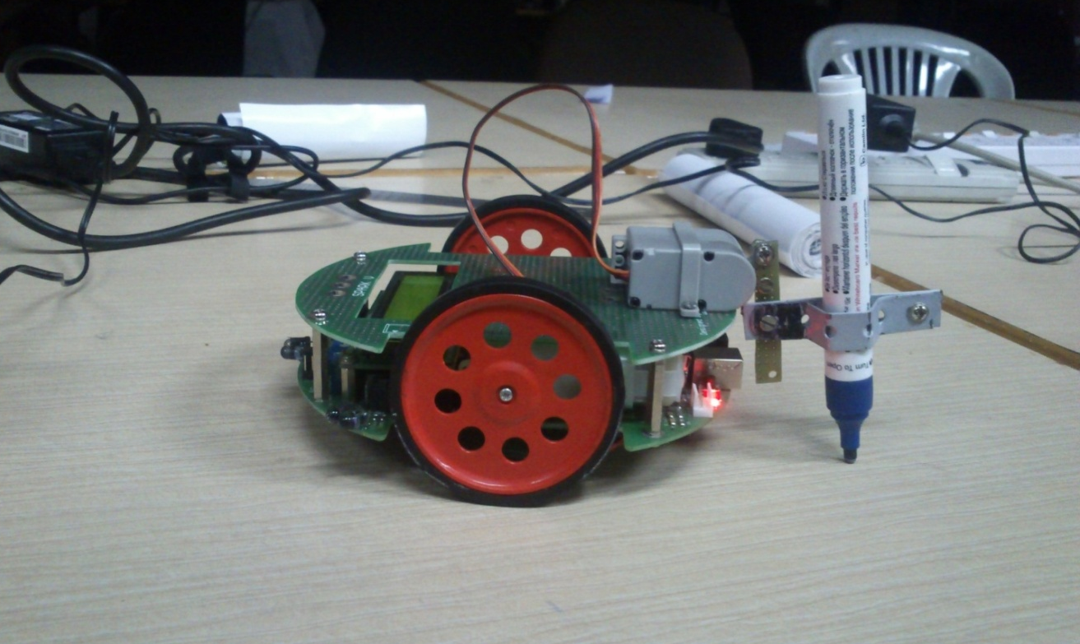
TEST CASES
STAGE 1: ATTACHING SERVO MOTOR TO ROBOT

Slide 19
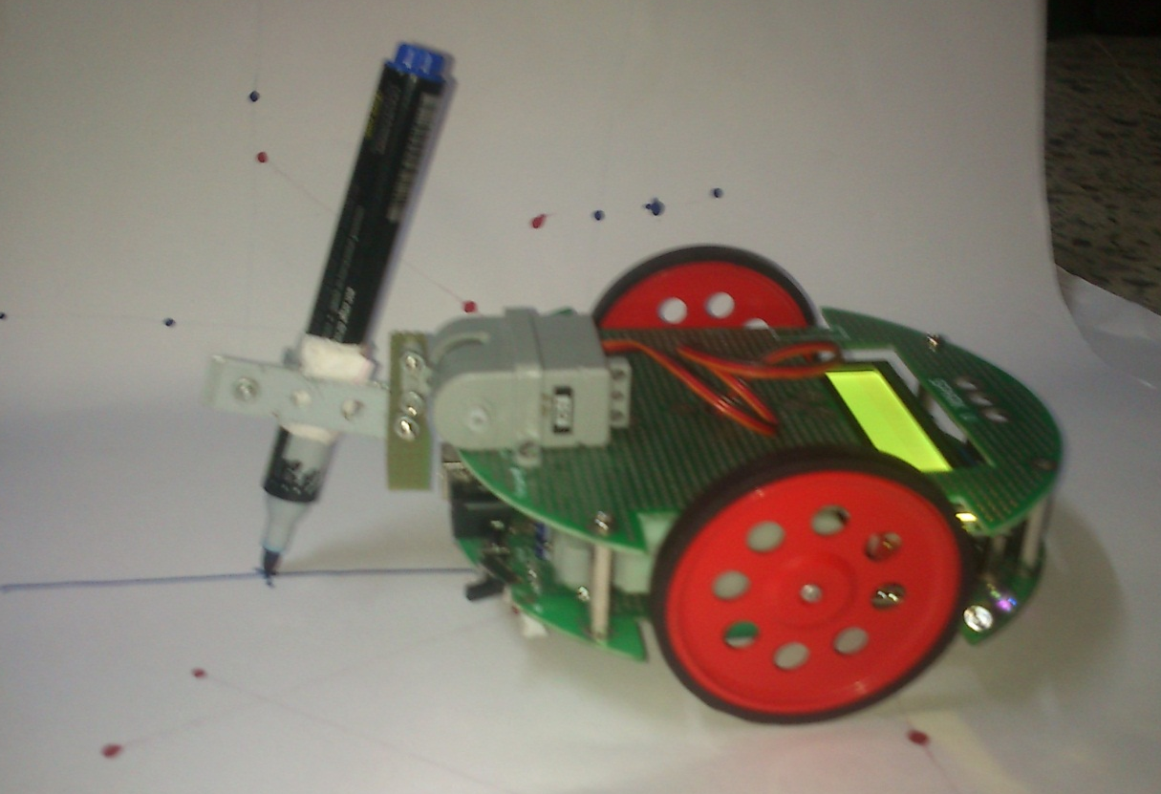
STAGE 2: MOVING ROBOT ALONG A STRAIGHT LINE

Slide 20
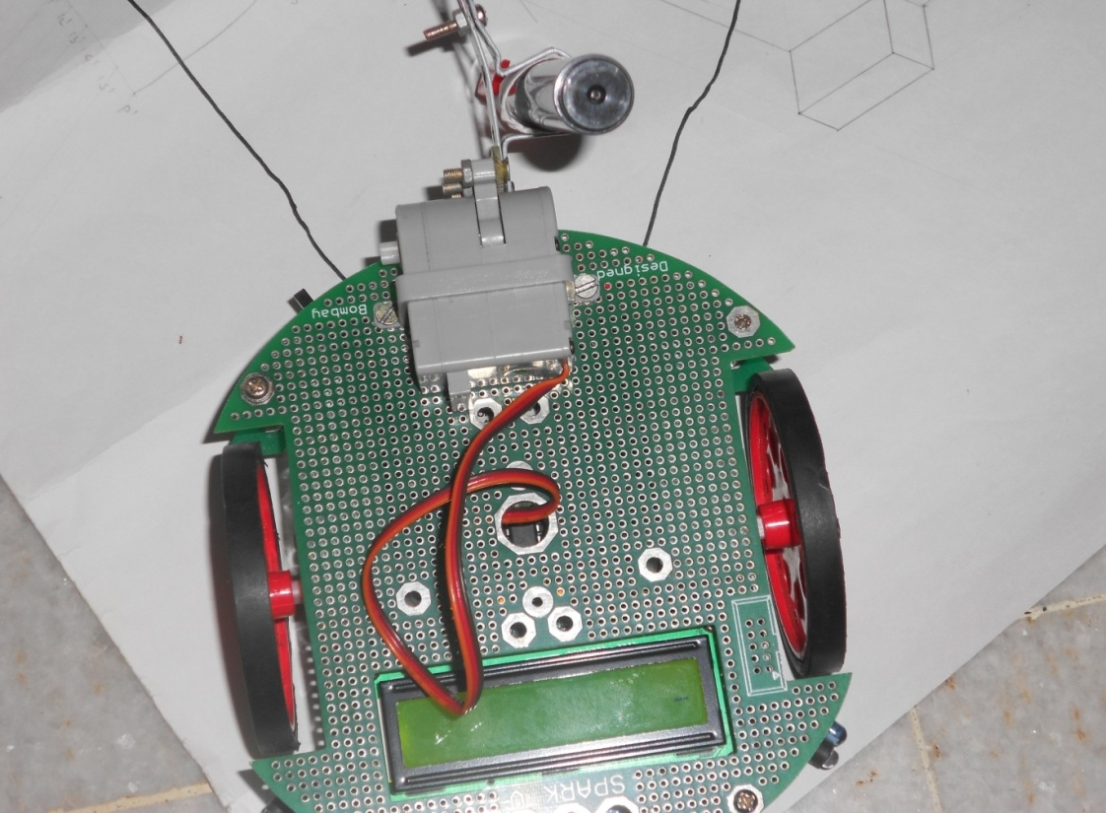
STAGE 3: MAKING ROBOT TURN ALONG A PARTICULAR ANGLE

Slide 21
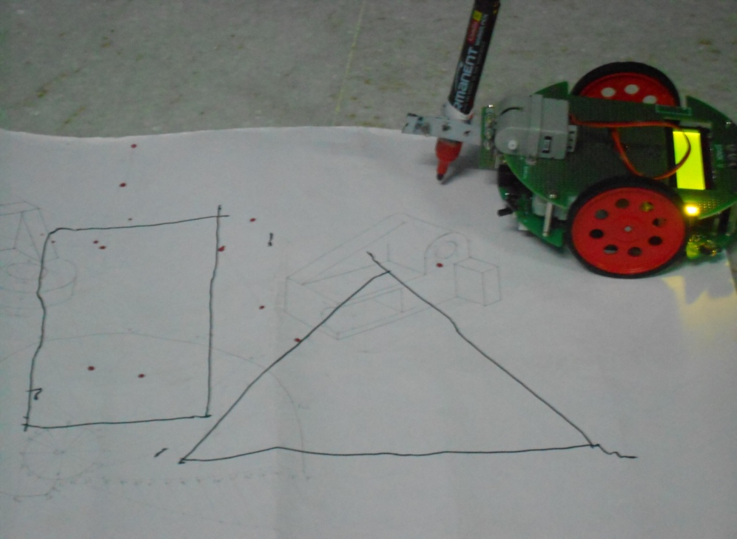
STAGE 4: TRAVERSING ROBOT ALONG THE EDGES OF ANY PARTICULAR SHAPE

Slide 22
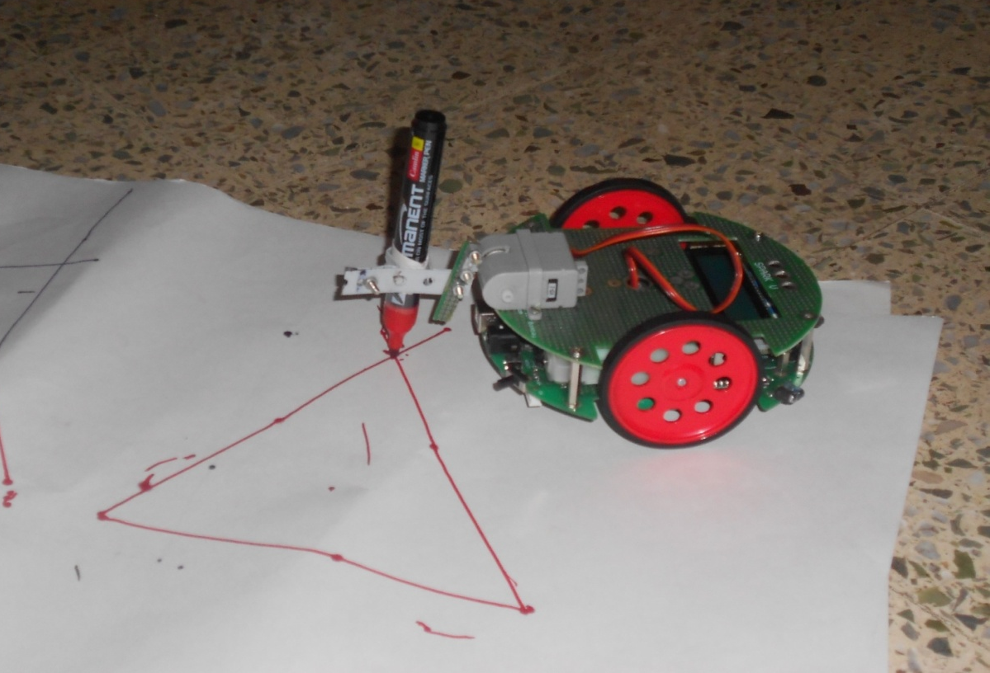
STAGE 5 : DRAWING THE REQUIRED SHAPES

Slide 23
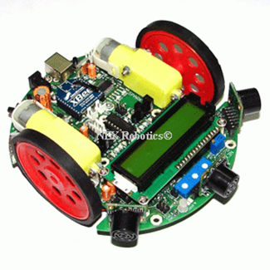
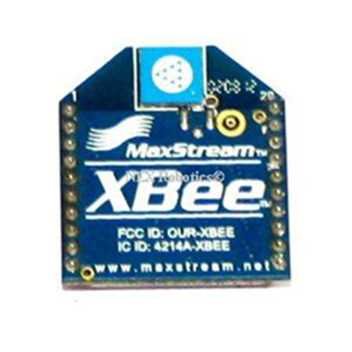
Hardware requirements
Spark V or Equivalent robot capable of working in a swarm environment
Robotic arm with capability to support the colouring utility.
VS1 Servo motor

Slide 24

Software Requirements
Win AVR
Matlab
Windows XP or higher

Slide 25
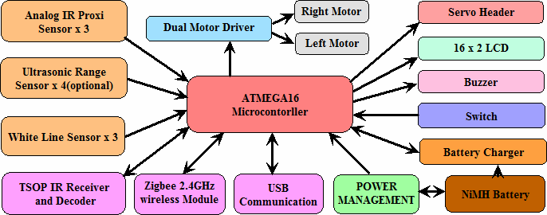
SPARK V-ATMEGA 16 AVR
Functional Block Diagram

Slide 26
Features-ATMEGA 16
High-performance, Low-power AVR 8-bit Microcontroller
Up to 16 MIPS Throughput at 16 MHz
32 Programmable I/O Lines
16K Bytes of In-System Self-programmable Flash program memory
512 Bytes EEPROM
1K Byte Internal SRAM
Four PWM Channels
8-channel, 10-bit ADC
Byte-oriented Two-wire Serial Interface (I2C)
Programmable Serial USART
Master/Slave SPI Serial Interface

Slide 27
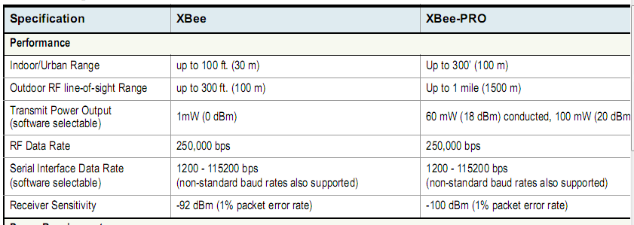
XBEE module

Slide 28
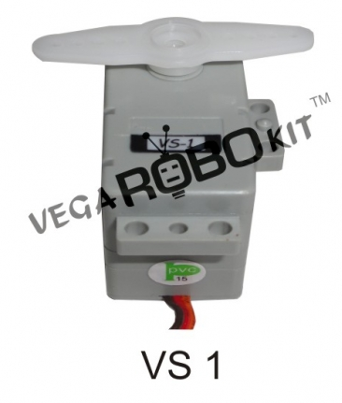
VS 1 Servo motor
Operating Voltage : 4.8-6.0V
PWM Input Range : Pulse Cycle 20±2ms, Positive Pulse 1~2ms
STD Direction : Counter Clockwise / Pulse Traveling 1500 to 1900µsec
Stall Torque : 3.6 kgf.cm (50.04 oz/in) at 4.8V,4 kgf.cm (55.6 oz/in) at 6V
Operating Speed : 0.23sec/ 60° at no load at 4.8V, 0.18 sec/ 60° at no load at 6V
Weight : 34g (1.19 oz)
Size : 40.5 x 20.2 x 33.7mm
Plug Available : FUT, JR
Special Feature : Robot Type

Slide 29
Limitations
A mechanical defect present in almost all SPARK V robots is that the PWMs(Pulse Width Modulators).
Being an 8-bit microcontroller, calculation capacity is limited
Only straight lines can be created, no curves can be drawn currently by this robot.
The swarm of robots we have created will detect and draw shapes in only the 3 basic colors red, green & blue.

Slide 30
Applications
Automated creation of symmetric and asymmetric figures.
Creation of various forms of drawing like complex architectural and engineering ideas.
Fine art may also be created.

Slide 31
THANK YOU

